Slide 1

Bonitron Inc.
Dedicated To Engineering Quality Industrial Electronics Since 1962!
1
Notes:
Nashville TN

Slide 2

Presentation Topics
Zero Down Time
AC Line Loss Events Defined
AC Line Loss
Company Introduction
DC Bus Management
VFD Current Backup Solutions
UPD – Uninterruptable Power for Drives
UPD Specification
Critical Process Applications
Critical Process Protection
UPD Maintenance & Installation

Slide 3
Introduction
Location: Nashville, TN
Nashville, TN
USA
Manufacture of VFD Accessories and Engineered Solutions
All Products Designed by
Bonitron Inc. Engineering
Company Profile
Notes:
Some people know us as the braking guys some as the regen guys but what we do is a full line of DC bus management products

Slide 4
Introduction
1962-1973 Government Contracting for Acoustical Analysis Product Design
Est. 1962 by Dr. Robert Benson as an Engineering and Design Company
Bonitron’s Products Installed in the 70s are Still Operational Today
First VFD Solutions Designed for The Fibers Industry
Installed With DuPont In the Mid 1990s
First Power Dip Ride Thru Designed
For Spin Injection Pumps AC Line Sag Protection
Company History
Notes:
Some people know us as the braking guys some as the regen guys but what we do is a full line of DC bus management products

Slide 5
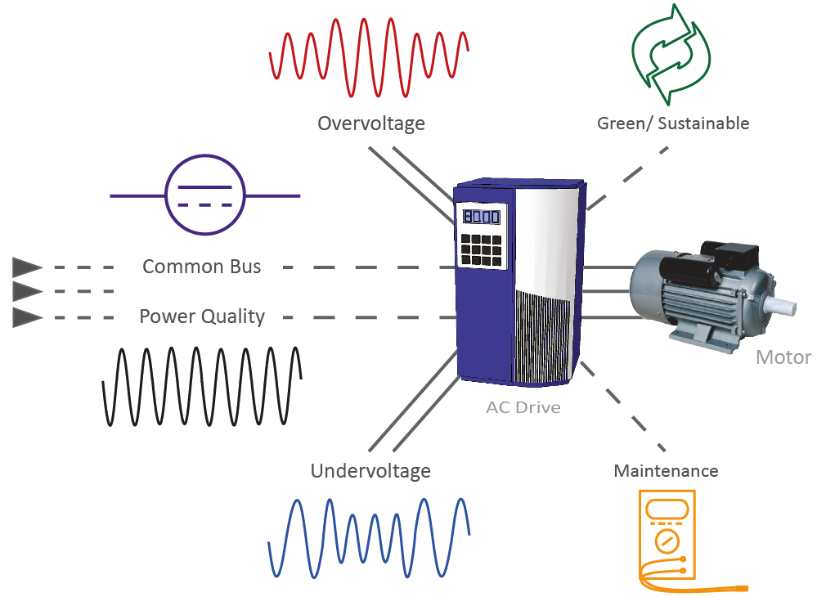
DC Bus Management
Bonitron Solutions for Commercial & Industrial VSD Application
Over Voltage Products
Resistive Braking
Line Regeneration
E-Stop Servo Braking
Under Voltage Products
UPD Power Dip Protection
UPD Full Outage Protection
Energy Storage Options
Common Bus Products
Drive Front End Rectifiers with or without precharge
Single Phase Power Supplies
Common Bus Diode Sharing Bus Snubbing Modules
Add-on Capacitance Modules
Notes:
Some people know us as the braking guys some as the regen guys but what we do is a full line of DC bus management products

Slide 6
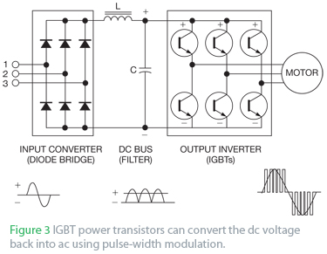
Drive DC Bus Management
Bonitron Solutions Standard Connectivity & Features
Standard Product Power Connections - 3 AC Line and 2 DC Bus, Control Power Options
Standard Unit Connectivity Make’s New Installations or Retrofits Easy and Non-Invasive to The Drive…
WE WON’T VOID A DRIVES WARRANTY!
Any Brand Drive with Accessible Bus Capacitor Connections
Our Products Support all Line Voltages and Power Backup Requirements World Wide
Enable Circuits, Ethernet Comms. or Control Power Options May Add a Few More Connections
Notes:
Bonitron products work with any drive brand with DC +/- connections.

Slide 7

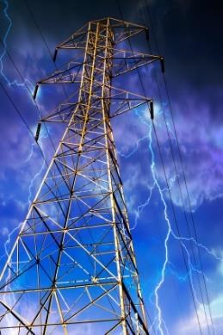

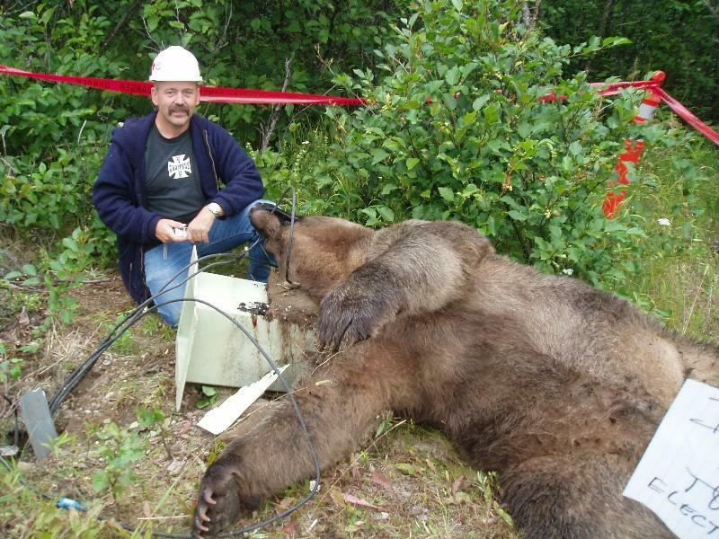
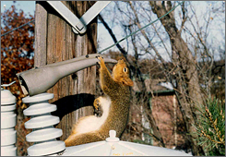
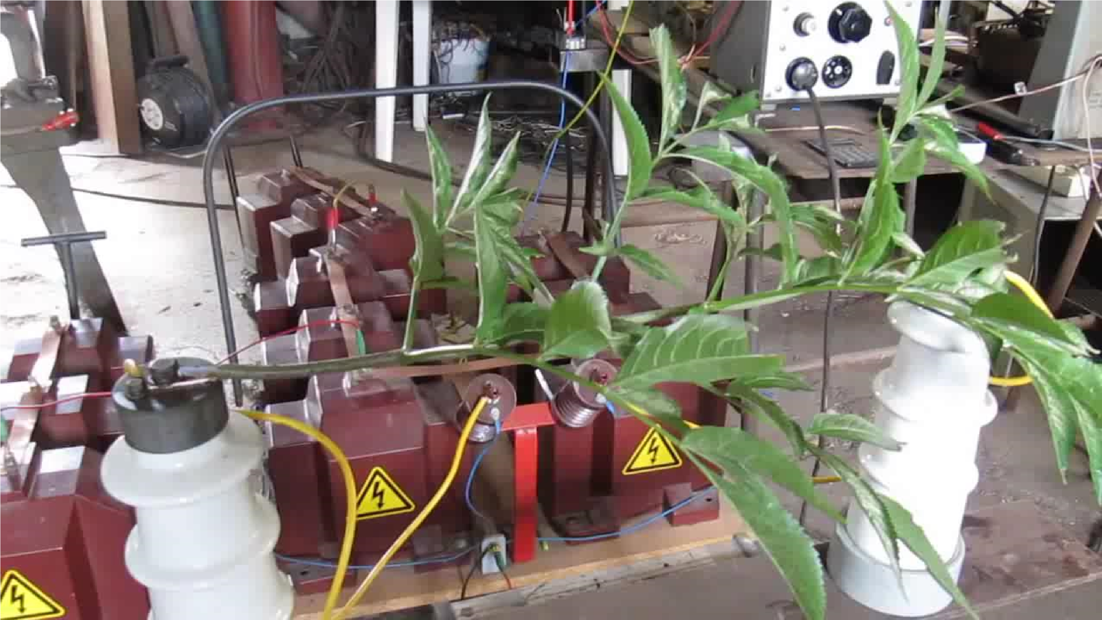
AC Line Loss
Environmental Conditions
Fallen Trees
Flooding
Lightning Strikes
Mother Nature
Human Nature…
Slide
34
7

Slide 8
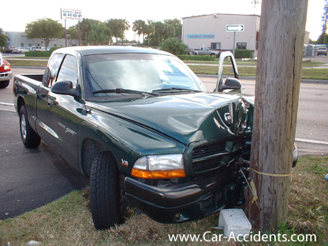
AC Line Loss
The Classic

Slide 9
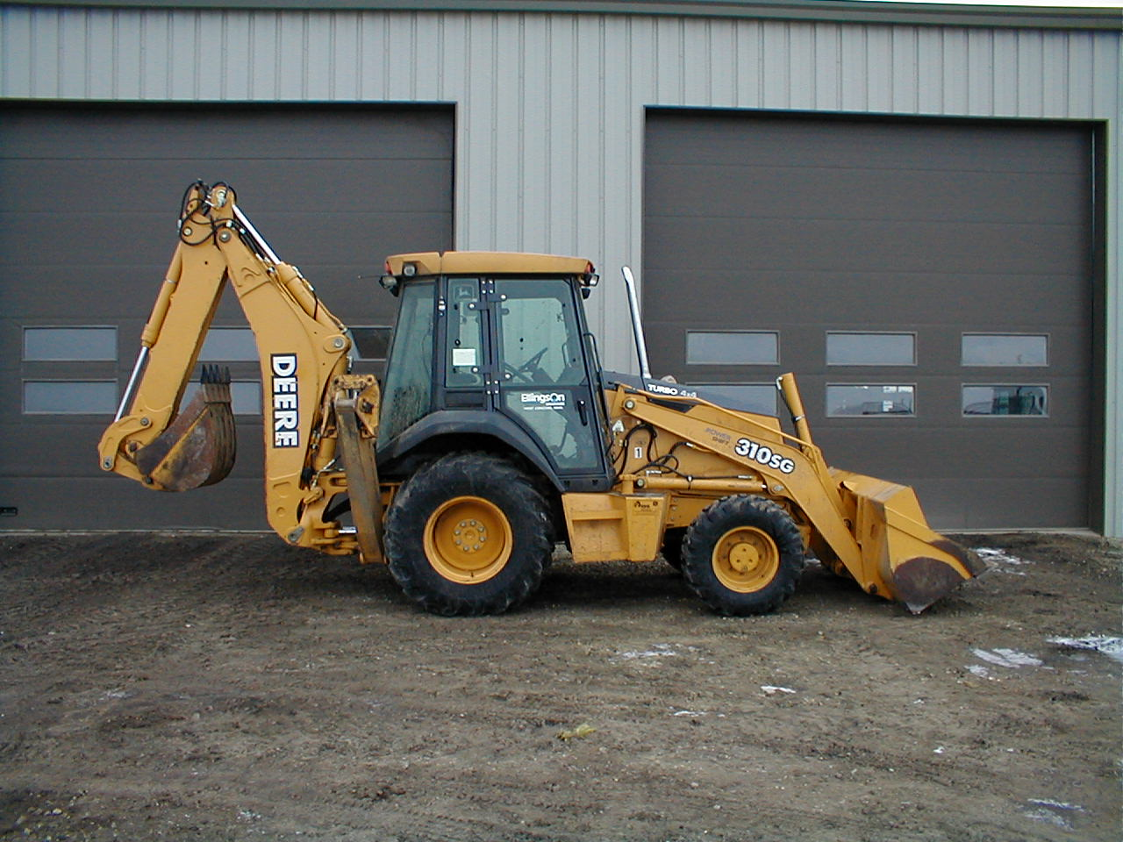
AC Line Loss
Singapore Power Quality Problem
9
Notes:
~ NOTES ~
___________________________________________________________________________________________________________________________________________________________________________________________________________________________________________________________________________________________________________________________________________________________________________________________________________________________________________________________________________________________________________________________________________________________________________________________________________________________________________________________________________________________________________________________________________________________________________________________________________________________________________________________________________________________________________________________________________________________________________________________________________________________________________________________________________________________________________________________________________________________________________________________________________________________________________________________________________________________________________________________________________________________________________

Slide 10
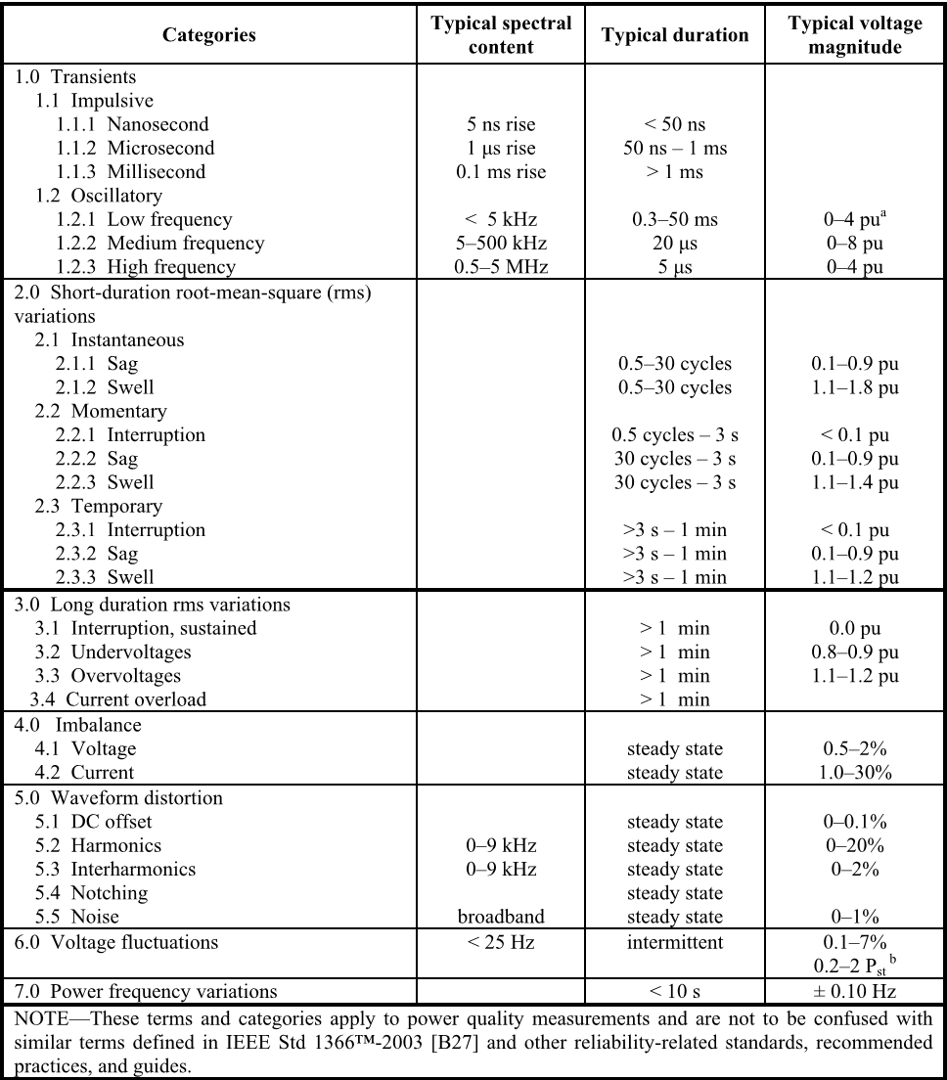
AC Line Loss
Table of IEEE Standard PQ Event Specifications - 1159-2009
Sags & Outage Events
Voltage Sags
  10-90% of nominal
Outages/Interruptions
  < 10% of nominal
Instantaneous
  ½ to 30 cycles (½ sec)
Momentary
  ½ to 3 seconds
Temporary
  3 seconds to 1 minute
Sustained
  > 1 minute

Slide 11
AC Line Loss
3 Phase AC Line Power Sags – 60% Sag /100% Single Phase Outage
100% AC Line Loss - Short Term
100% AC Line Loss - Long Term Outages
As Defined by Bonitron in Relation to Required Energy Storage 0.5-2 Seconds = Short Term Outage
Occurs When Feed or Line Equipment Fails
Sags Are Defined by % of Total AC Input Loss and Time Duration During a Utility Power Event
Utility Induced Sag Events Experienced in US are on the Average Less Than 60% (40% Remaining AC Total Line)
Sags Cause a “Brown Out “ Condition or Momentary Single Phase 100% Loss, or 3 Phase (Phase to Phase) Low Voltage Condition
AC Line Sags Create DC Bus Under-voltage Condition Tripping The Variable Frequency Drive During Critical Process Operation
Process Level Backup Comes Down to a Balance Between Most Cost-Effective Solution and Required Specification Coverage
Caused by Utility Switching or Load Deviation
More Infrequent Than Sags or Transients
ANY Energy Storage Can Be Adapted to a Requested Specification. $$$ = Power and Time
Plant Wide Protection Does Not Cover Some Process Level PQ Events
Smallest % of Utility Power Events Requiring Drive Level Protection
Generators Come online in 5-30 Seconds
Drives Shut Down due to Long Term Loss of AC Line Input
Multi Axis Servo Drive Systems Lose Reference Mid Task
As Defined by Bonitron in Relation to Required Energy Storage Greater Than 3-15 Seconds = Long Term Outage
Equipment Susceptibility to Line Voltage Events Varies
We Have Rated Our Equipment to Full Motor Load Requirements During Event.
Notes:
11
~ NOTES ~
SHORT TERM OUTAGE - For Any Outage Times Over 2 Seconds 100% Full AC Line Loss Considering Ultra capacitors Contact Engineering Department
Stephen Collings
Hanna Malak
Ethan Humphries

Slide 12
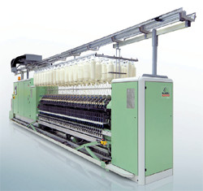
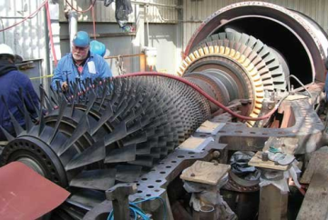

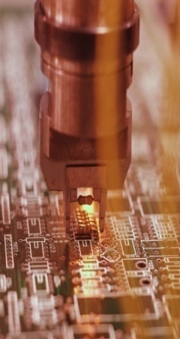
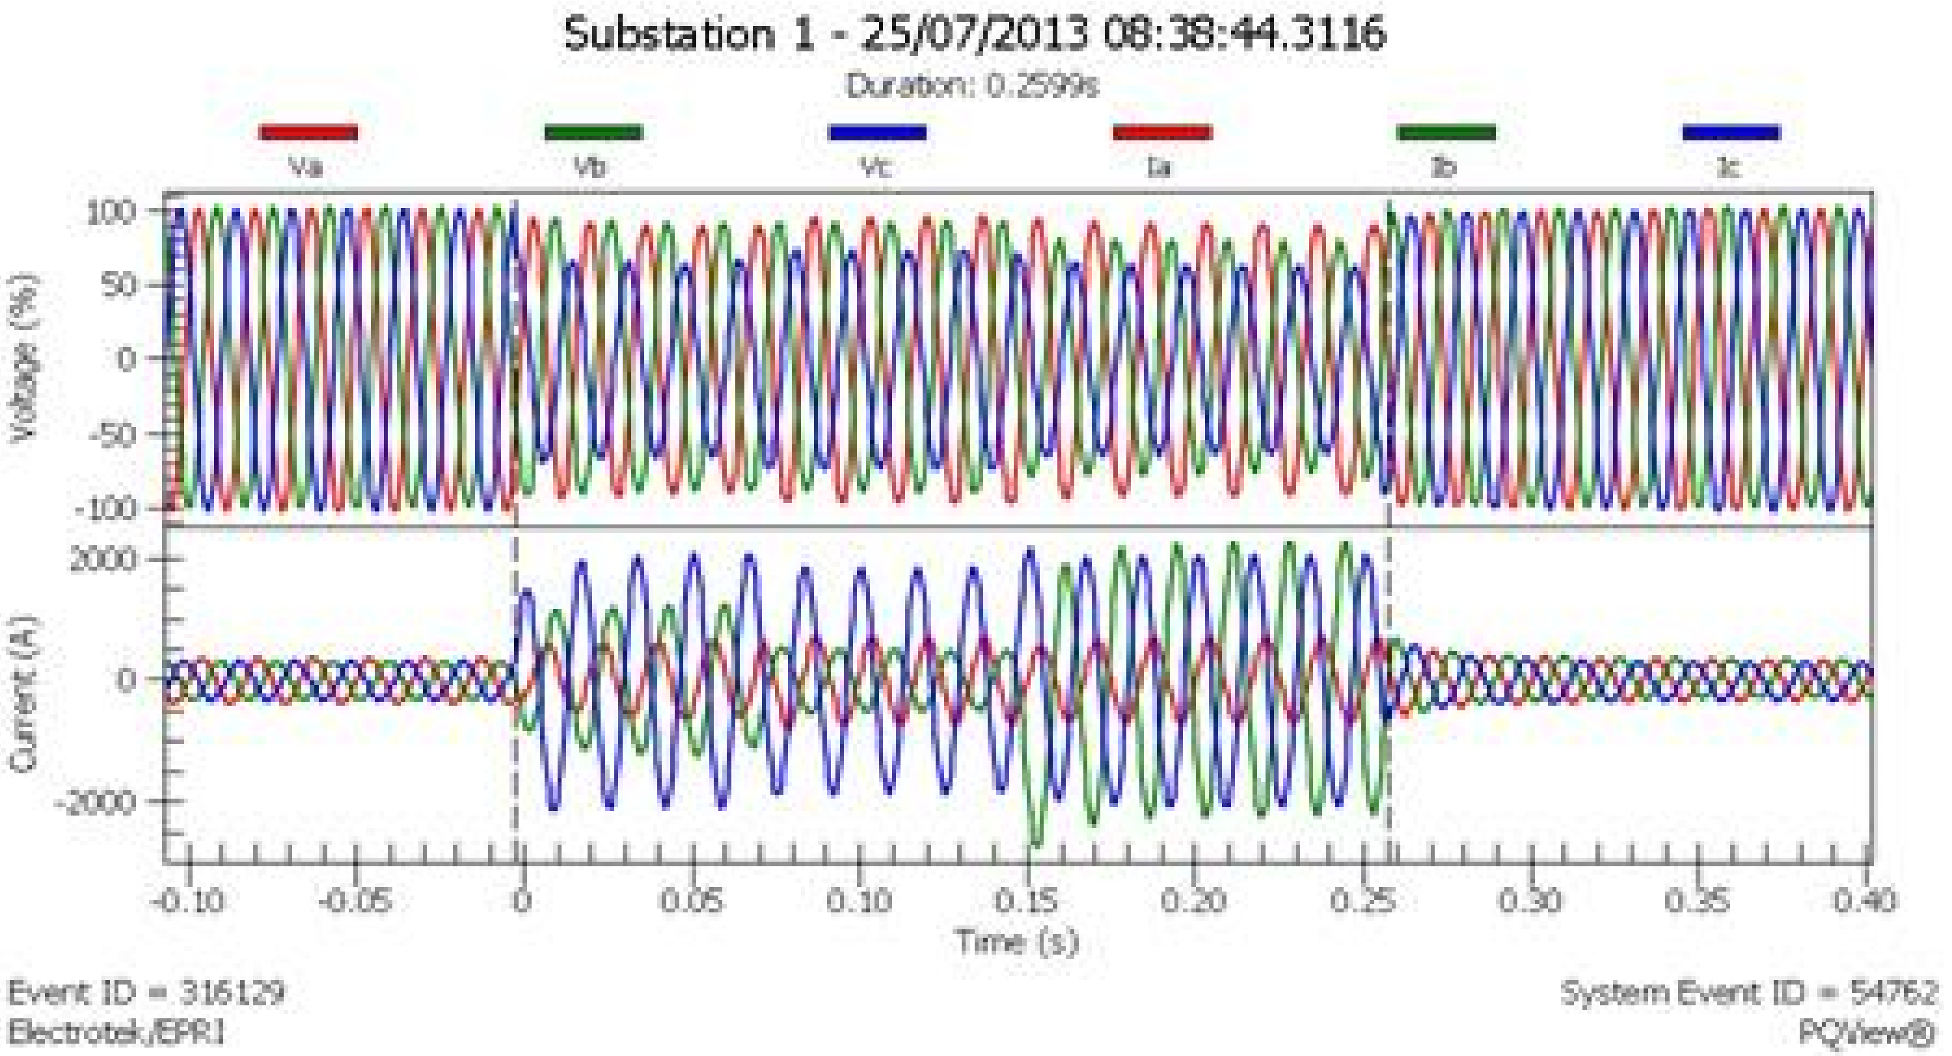
Critical Process Protection
What is a Critical Process?
Critical Process Backup Reasons
Personnel Safety Can Be Compromised if the Associated Process Motor Losses Power and Becomes Erratic
Data Centers – Environmental Systems Backup
Critical Process Examples
Semiconductor – Cleanroom Air Handlers & Machine Tool Chill Water
Lubrication Systems
Safety Systems
Security Gates
Loss of Security System Power Can Allow Intrusion Into High Security Areas
Loss of Power to Equipment’s Personnel Safety Features Can Create Hazzard to Workers
Hoists & Cranes Can Drop Load
Power to Security Access Areas is Cut During Breach Attempts
Robotics Multi Axis Systems Lose Reference Causing Damage to Mechanical Components or Surrounding Equipment
High Speed Turbines Can Burn up Without Constant Lubrication
Cleans Rooms Must Remain Free of Environmental Particulates or Expensive Semiconductor Wafers are Discarded
Machine Tools for Wafer Etching Must maintain Constant Chill Water Cooling Due to High Speed Operation
Any Slight Deviation in Motor Speed or Torque Can Create Scrap Product and Expensive Production Loses or Cleanup
Critical Data Can Be Lost if Environmental Systems Are Lost and Data Servers Overheat
Chemical and Toxic Exhaust Ventilation
Loss of Ventilation and Exhaust Fans can Create Personnel Hazzard from Toxic Gases
Perishable Products can Be Lost During AC Line Loss that Can Trip Refrigeration Compressor VFDs/Motors

Slide 13


Critical Process Protection
Why Critical Process Ride Thru Backup?
Annual Losses Due To Each Event Type = Lost Revenue.
Safety!
Non-Productive Personnel
Broken Tool Repair
Reworking Equipment
Restarting Equipment
Specification Coverage Defined by Power Required and Time
Inadequate Specification Coverage & Solution Expense
Additional Redundancy Requirements for Critical Processes
Power Distribution Backup Does Not Address Internal Plant PQ Issues
Expensive Over Kill in PQ Solution Does Not Provide Adequate ROI
Lost or Scrape Product
Cleaning Equipment Before Restart
The Need for Process Level Protection
Losses in $$$

Slide 14
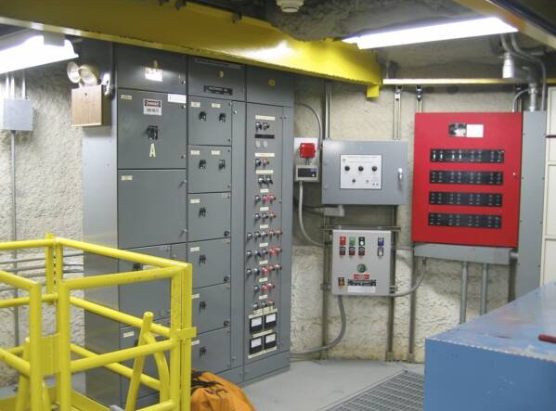
AC Line Loss
Causes for Internal Plant VFD Under Voltage Events
System & Drive Fault Settings
Internal Plant Load Switching
Internal Plant PQ

Slide 15
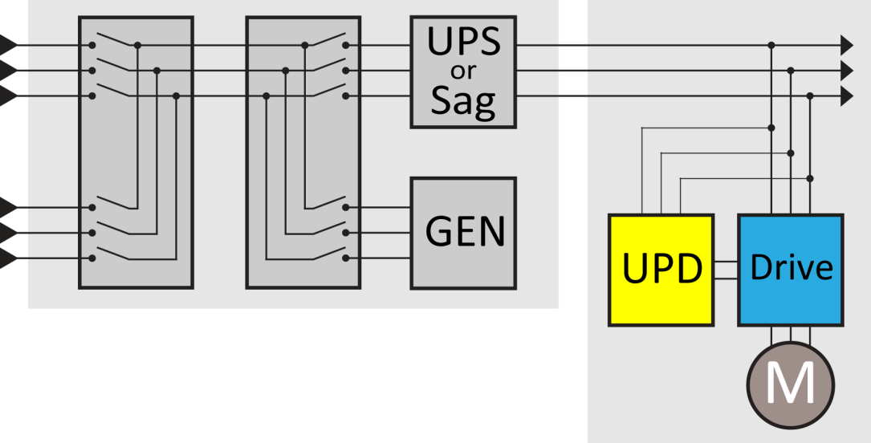
Typical Plant Redundancy Line Up
AC Line Loss
UPS provides minutes of “ride thru”
UPD provides seconds to minutes of “ride thru”
UPS Protects for Long Term AC Line at Power Distribution
AC Line Backup Source
Automatic Generator Bypass
AC Line
DC Bus Parallel Connected
UPD Protects VFD Until Generator Up
Plant Power Backup Levels of Redundancy – N+
Unlike typical plant wide solutions, Bonitron designed its UPD solutions to connect directly to the DC terminals of one or multiple drives. If drive voltage sags, the Bonitron UPD immediately provides power so motor speed is not affected and the process never sees a disturbance. When properly sized, Bonitron UPD systems provide drives with full-load power until the AC line is restored or generators are online.
Plant Power Backup Levels of Redundancy – N+ Levels

Slide 16
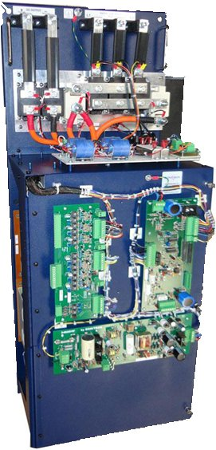
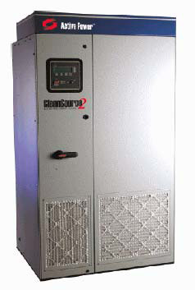


Current VFD Ride Thru Solutions
VSD Backup Solutions
UPS
AC Line Sag Corrector
Motor Inertia
DC Bus Ride Thru
VFD Active Front End

Slide 17
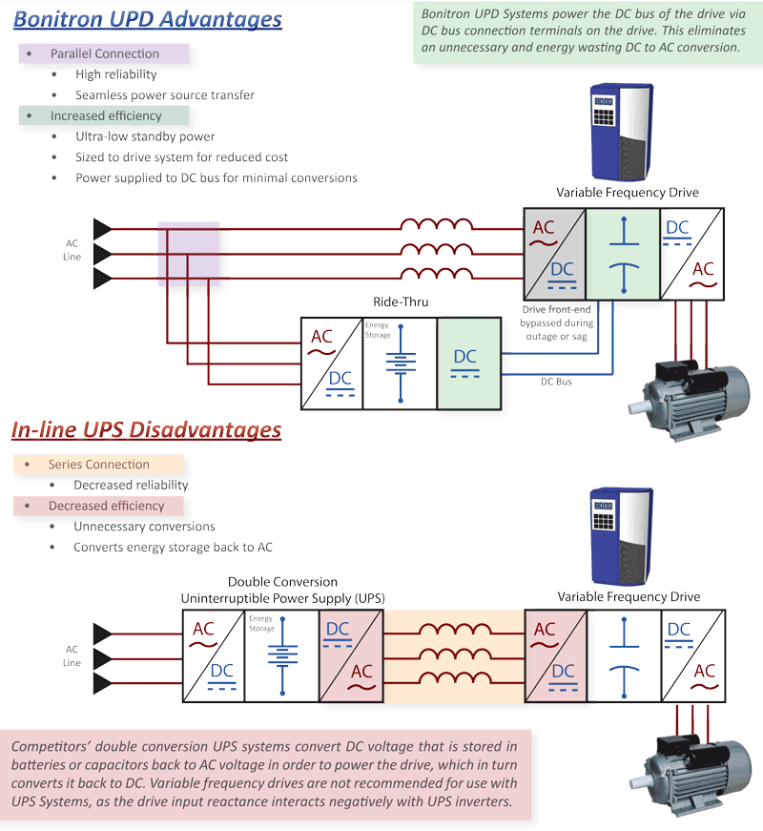
VSD Backup Solutions
Series Solutions Disadvantage
Reduced Efficiency Due To Extra Conversions
Extra Point Of Failure – Series Configuration
Drive Input Reactance Interacts With UPS Inverters and UPS Filtering
Must Be Over Sized To Anything The Drive Has To Handle…
In Rush Or Startup Currents – Series Solution
Batteries And Battery Maintenance Around Drives And Power Electronics
Routine Entire Battery String Change Out
Motor Inertia
Active Front Ends
Drive Fault Codes
DC Bus Capacitance
Kinetic Buffering
Drive Ride Thru Features
Series AC Solutions

Slide 18
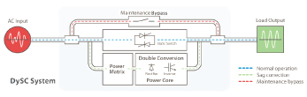
VSD Backup Solutions
Series AC Sag Corrector
Maintenance Bypass
AC Input
Load Output
Normal Operation
During Sag
During Maint.
Double Conversion Power Core

Slide 19
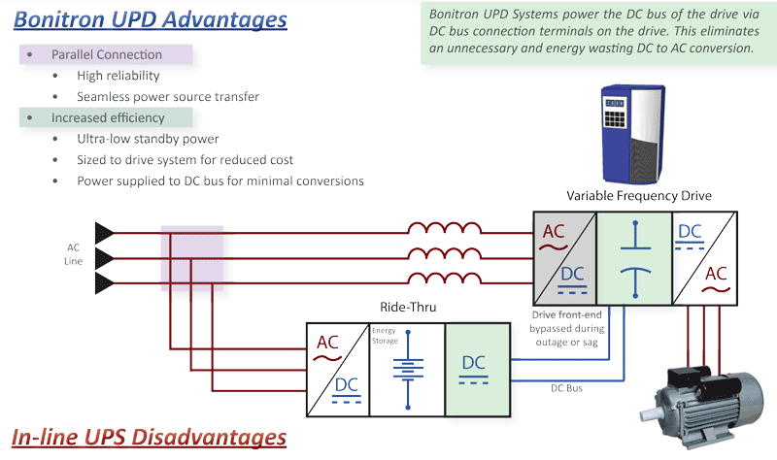
VSD Backup Solutions
Parallel DC Bus Ride Thru Solution
UPD DC Bus Solution Advantages
High Reliability – Does Not Affect Drive During Normal Operation
Seamless Power Source Transfer
Parallel Drive Connection
No Speed or Torque Change is Seen at The Motor
Ultralow Standby Power Consumption
Sized for Motor Load – Oversizing for Startup Currents Not Required
High Efficiency – AC/DC Single Conversion
During a Loss of AC Line Drive Input, the DC Bus Collapses.
Bonitron Voltage Regulator Booster Bypasses The Drive Converter and Directly Feeds the Drive’s DC Bus by Connecting Across the Drive’s DC bus Capacitors
Parallel Connectivity
When a DC Bus Low Voltage Threshold is Met, The Voltage Regulator Booster Becomes Active
Provides DC Bus Voltage Immediately
Voltage Regulator Booster

Slide 20
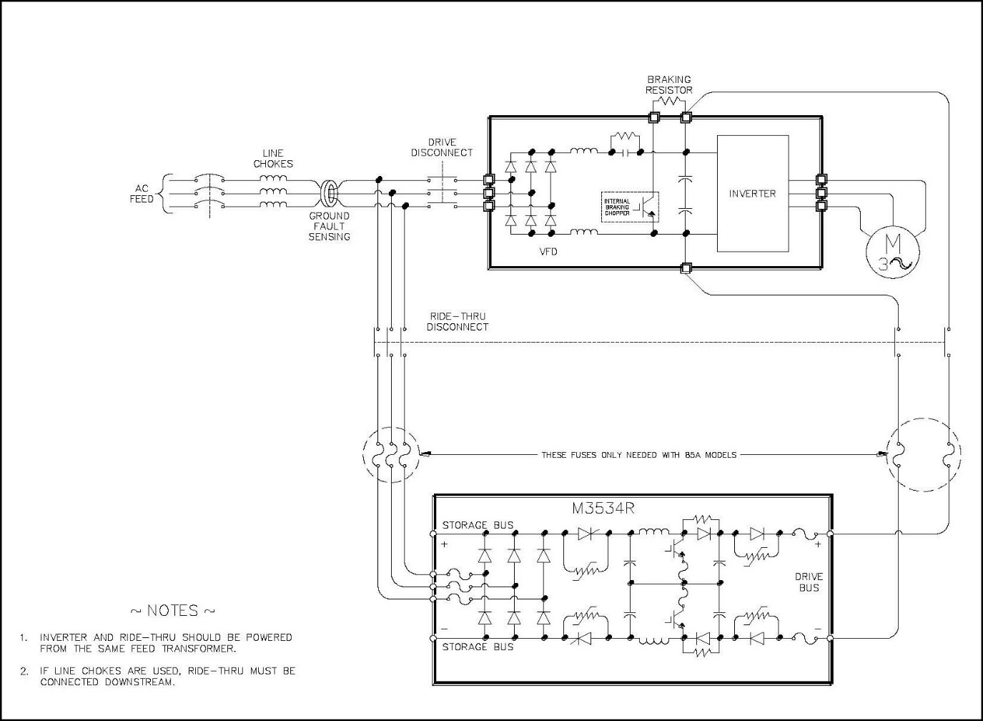

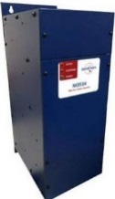
UPD – Uninterruptable Power For Drives
M3534R & M3460R Voltage Regulator Booster
The Stand Alone M3460 Or M3534R Is Utilized For 2-3 Second 3 Phase Sag Protection.
Does Not Require Additional Energy Storage.
The Single Unit Is Connected To The AC Line At The VSDs Ac Input Terminals And The VSDs Dc Bus.
It Will Protect From 60% 3 Phase Sags For 2-3 Seconds or Single Phase 100% with 40% Remaining AC Line Other 2 Phases.
We Use The Sag Ride Thru Voltage Regulator Booster For 2-3 Second Outages When Combined With Ultracapacitor Energy Storage.
If Using Common Bus Multiple Drives For One Ride Thru The Drives Must Be Connected To The Same AC Distribution.
10kW-50kW Single Unit
50kW-250kW Single Unit
Parallel Power Modules 250kW+

Slide 21


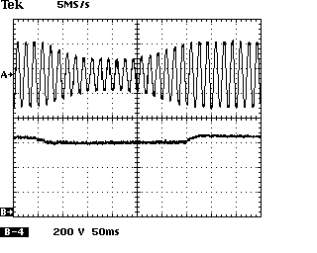
UPD – Uninterruptable Power For Drives
AC Line Sag with DC Bus Ride Thru
AC Input To VFD During Sag
Sags Are a Partial AC Line Loss
VFD DC Bus With Ride Thru
No Affect Seen By Process Flow Meters Or Sensors
VFD Does Not See Change In Motor Speed or Torque
A Single Voltage Regulator Booster Can Cover 60% Sags/40% Remaining 3 Phase AC Line for 2-3 Seconds
100% Single Phase AC Line Loss with 40% Total AC Line Remaining 2 Phases
100% 3 Phase AC Line Loss Requires Additional Energy Storage
Sags Are Not The Whole Problem. Returning AC Can Create Surges.
M3460R 50kW-250kW
M3534R 10kW-50kW
Notes:
21

Slide 22
UPD – Uninterruptable Power For Drives
Voltage Regulator Booster
C1 Control PCB
Diode Isolation
Power Connections AC and DC
D5 Power Supply PCB
M6 Interface PCB
Ride Thru Bus Capacitors & IGBTs

Slide 23
UPD – Uninterruptable Power For Drives
M3534R & M3460R Voltage Regulator Booster
The Stand Alone M3460 Or M3534R Is Utilized For 2-3 Second 3 Phase Sag Protection.
Does Not Require Additional Energy Storage.
The Single Unit Is Connected To The AC Line At The VSDs Ac Input Terminals And The VSDs Dc Bus.
It Will Protect From 60% 3 Phase Sags For 2-3 Seconds or Single Phase 100% with 40% Remaining AC Line Other 2 Phases.
We Use The Sag Ride Thru Voltage Regulator Booster For 2-3 Second Outages When Combined With Ultracapacitor Energy Storage.
If Using Common Bus Multiple Drives For One Ride Thru The Drives Must Be Connected To The Same AC Distribution.
10kW-50kW Single Unit
50kW-250kW Single Unit
Parallel Power Modules 250kW+

Slide 24
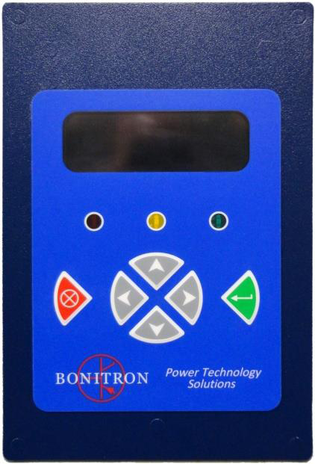
UPD – Uninterruptable Power For Drives
M3660-DD4 Digital Display
Records Menu
View Ride Thru event statistics or individual event records
Actions Menu
Threshold Check
DC Bus Voltage Fault Logic
TEST Initiate
The system ships with records of a single event initiated during checkout
RT Event Parameters
100 most recent fault states
Configurations Menu
Set Time
Set Status Timer
LEDs
Green – Power
Amber – Ride Thru or Charger Active
Red - Fault

Slide 25
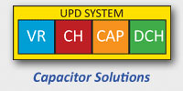
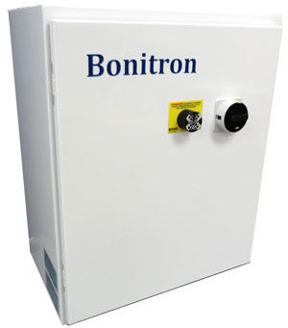
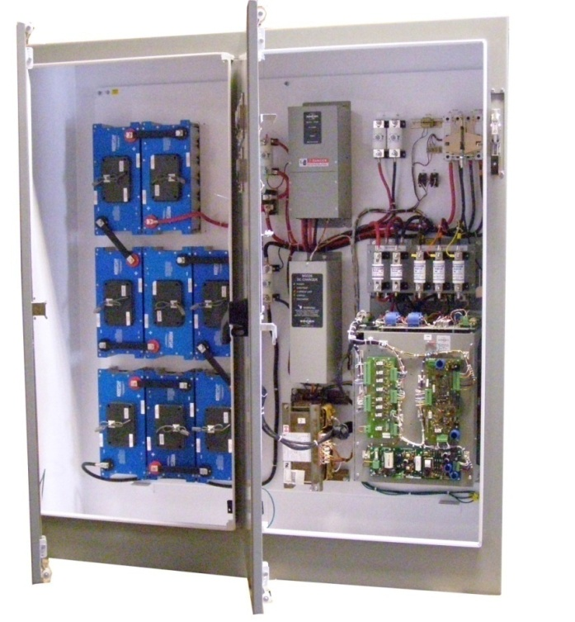
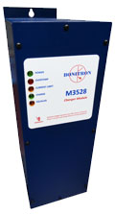
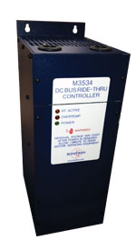
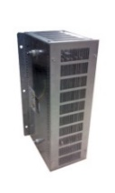
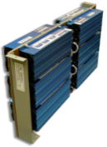

UPD – Uninterruptable Power For Drives
AC Line Sag/DC Bus Ride Thru
Short Term Outage
Ultracapacitor
Electrolytic
M3460R - 0.5 – 2 Seconds
Less Than 15kW Less Than 0.5 Sec
Requires Charger and Discharger
Does Not Require Charger or Discharger
100% 3-phase outages
M3460B – Up to 15 Seconds (Energy Storage is Load Dependent)
Voltage Regulator Booster
Charger
Capacitor Energy Storage
Discharger
60Hp 1 Second Full AC Line Loss Energy Storage Included
150kW 1 Second Full AC Line Loss Energy Storage Included in Adjoining Bay

Slide 26
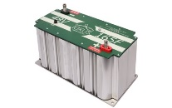
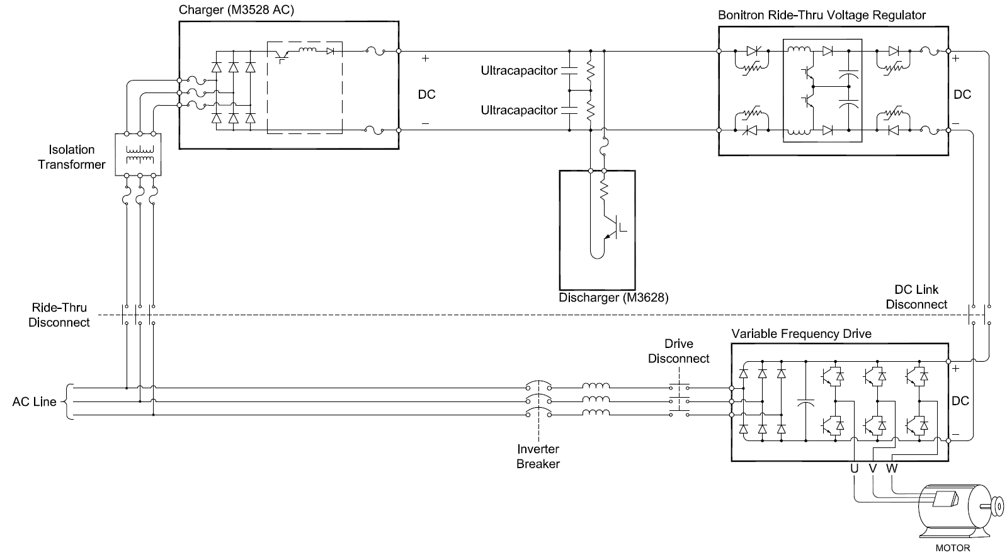
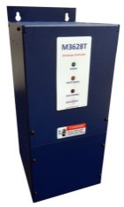

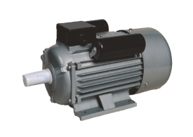
UPD – Uninterruptable Power For Drives
DC Ultracapacitor Ride Thru

Slide 27
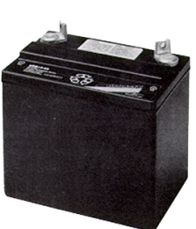

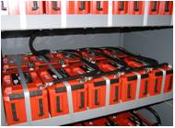
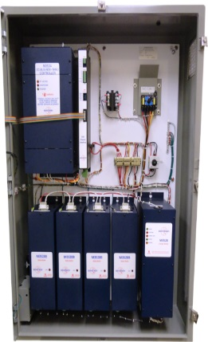
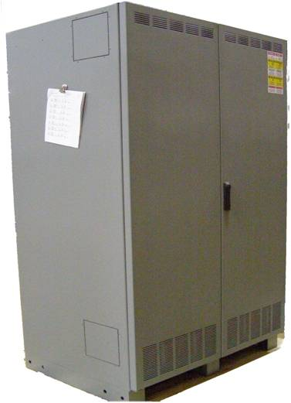
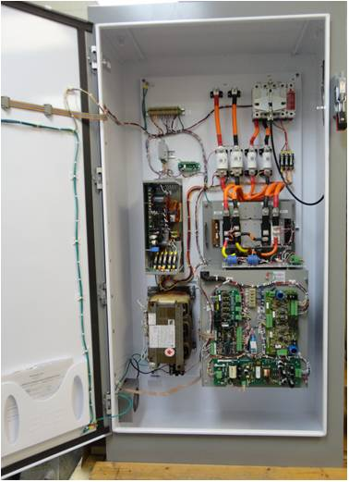
UPD – Uninterruptable Power For Drives
AC Line Long Term Outage
Long Term Energy Storage
100% 3-Phase Outages
Does Not Require Discharger
10-15 Seconds (Energy Storage Type Load Dependent)
VRLA Standard, Other Battery Types Available
Up to 30 Minutes - Battery Energy Storage
VR - Voltage Regulator Booster
CH - Charger
B - Battery Energy Storage
230VAC, 50kW
30 Seconds Battery Energy Storage Included
460VAC, 250kW
15 Minutes
Battery Energy Storage

Slide 28
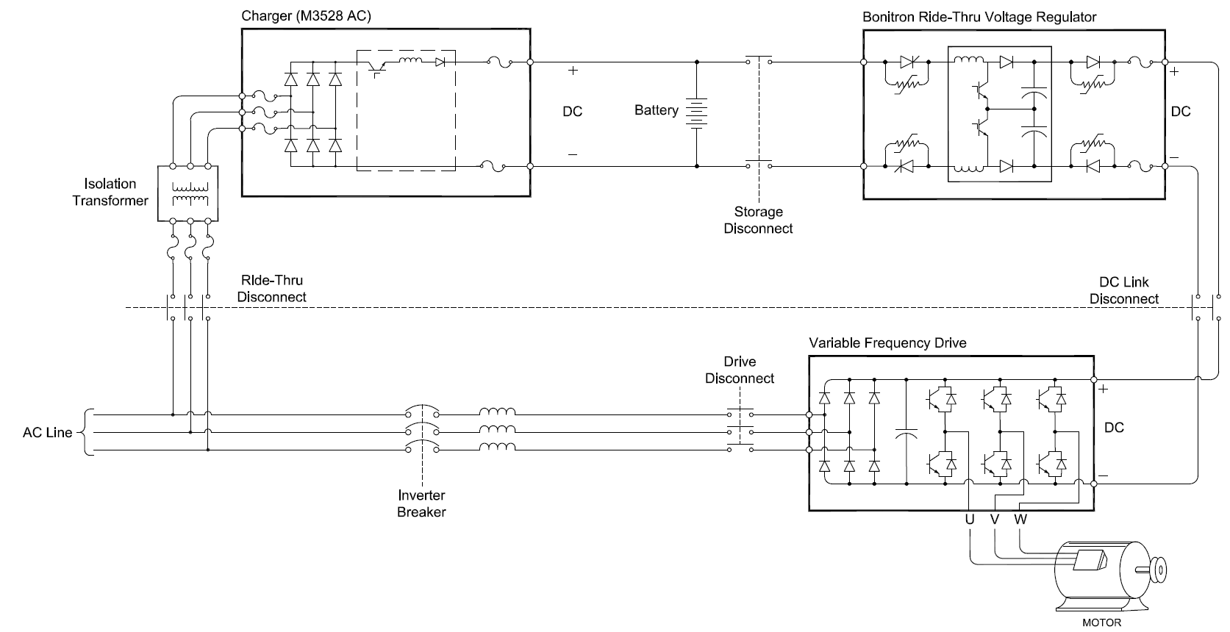
UPD – Uninterruptable Power For Drives
DC Battery Ride Thru
Notes:
This is a battery backup system showing the main power input at the bottom for the VFD. During normal operation, the charger maintains the battery level for a power quality event.
During the outage, the battery voltage is regulated to a level that allows for full power output during an outage.

Slide 29

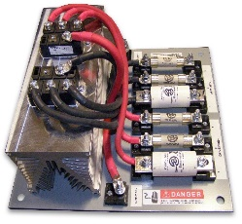








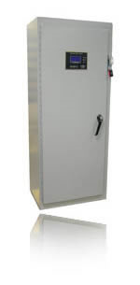
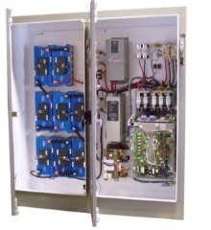
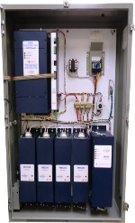
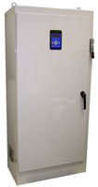
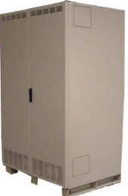
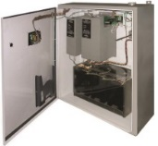
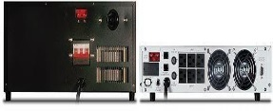




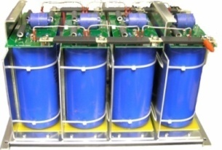

UPD AC Line Loss/DC Bus Backup Products
UPD – Uninterruptable Power For Drives
UPD 100% AC Line Loss Integratable Modules
UPD Integratable Sag Modules
M3534B/M3460B (HD Booster) Ultracapacitor 3-15 Seconds
M3534B/M3460B + Batteries 15 Seconds to 60 Minutes +
UPD Multiple Drive Solution
M3534R 2-3 Seconds 60% Sags
M3460R 2-3 Seconds 60% Sags
M3460D UPD RT Common Bus Diodes
0.5 to 15 Seconds
15 Seconds to 60 Minutes
UPD Sag Cabinet Systems
S3534SR – 2-3 Second 60% Sags – 10-50kW
S3460SR – 2-3 Second 60% Sags – 50-250kW+
Control Power Backup
Sags & Outages
UPD 100% AC Line Loss Cabinet Systems
M3800 Regen Bidirectional Capacitor Controller
S3534UR, S3460UR – 3-15 Seconds – 10-250kW
S3534BR, S3460BR –15 Seconds to 60+ Minutes – 10-250kW+
24VDC, 120VAC Control Power Ride Thru
0.5-3 Second 100% AC Line Loss Modules
M3534R + Ucaps – 0.5-3 Seconds AC Line Loss
M3460R + Ucaps – 0.5-3 Seconds AC Line Loss
29
Notes:
Bonitron has 3 series of braking transistors. Act as switch that allows overvoltage to flow into resistor to prevent drive faults.
Example – AB drive OV fault 810VDC, Bonitron Transistor turns on at 750VDC

Slide 30


UPD – Uninterruptable Power For Drives
Energy Storage Types to Time Specs.
Electrolytic Capacitors
Ultracapacitors
VRLA Standard Batteries
700V Assembly
48V Modules
12V Battery
Up to ½ Second Full Outage
½ Second Outages
Used With M3534EC
Low Hp Drives
Less Than 15kW
Up to 15 Seconds Full Outage
Cost Effective for Short Outages
Can Be Used With
M3460R (Up To 3 Sec)
M3460B (3-10 Sec)
Low to High Hp Drives
10-1000+ kW
Selection – Cost & Space Available
kW x Outage Time = kJoules
Capacitance = 2(kJ) / V Squared
Up to 15 Minutes + Full Outage
Cost Effective For Long Outages
Used With M3460B Exclusively
(10 Seconds +)
Low to High Hp Drives
10-1000+ kW
Selection – Cost & Space Available
480VAC – 40 Batteries
380-415VAC – 36 Batteries
Notes:
30
Electrolytic and Ultracapacitors are 10+ years with no maintenance.
Batteries would be serviced the same as UPS applications, great support from local service providers.

Slide 31


UPD – Uninterruptable Power For Drives
Model Number Selection
Sag Protection
Outage Protection
Up to 250kW Single Unit.
3 Second Sags 40% AC Line Remaining
Up to 250kW Single Unit
Up to Sags to Minutes
Full Cabinet Systems Are Designated With An “S” In Front Of Model Number And Separate Modules Are Designated With An “M”
Model Number Designators
M = Module
S = System
BR = Batteries
SR = Sag RT
UR = Ultracapacitor
CR = Low Hp Electrolytic Caps
EC = Low Hp Electrolytic Caps
31

Slide 32


Critical Process Protection
Data Centers
Backup Utility Power Circuits
Utility Substation
Cooling
Tower
Switching Relays
Chiller
Chill Water Tanks
AC Line Plant Input Distribution
Air Handler
Main Utility Plant
Backup Utility Distribution
Chiller
Air Handling Fans
Cooling Tower
Chilled Water Loop
Chill Water Must Be Maintained to HVAC Systems 100%
Particulate Contamination Can Compromise And Damage Filtration Systems & Sensitive Digital Circuitry
Chill Water System Sensors Can Shut Down a Systems Even Though The Associated VSD Does Not Trip
Usually Outdoors – Nema 3R
Data Center Redundancy
N+ Levels
N+1
N+2
N+3
N+4
Drive Cabinet
Data Center Racks
Bonitron UPD VSD DC Bus Backup
Notes:
Utility
Substations
Exposed power lines
Transformers
Backup Switching
Control Room
UPS or Sag Corrector
Oversized plant-wide solution
Process still vulnerable to PQ issues within plant
Bonitron UPD
Direct drive connection at drive location

Slide 33





Critical Process Protection
Single UPD – Multiple Drives M3460D Diode Sharing
Chiller
Air Handling Fans
Cooling Tower
Chilled Water Loop
VFD Chill Water Pumps
Decrease in Chill Water Flow Can Trip Associated Equipment
Outdoor Nema 3R
Multiple Drives – One UPD
Constant Airflow
Contamination Levels
VSD does not Trip
Additional Process Equipment
Light Curtains
Safety Sensors
Drive Control Power
PLC Networks
Remote Monitoring Stations

Slide 34

Critical Process Protection
Semiconductor
Backup Utility Power Circuits
Utility Substation
Switching Relays
Cooling
Tower
Chiller
Chill Water Tanks
AC Line Plant Input Distribution
Air Handler
Backup Generation or Cogeneration
Wafer Etching Clean Rooms
Constant Airflow Required For Maintaining Uncontaminated Wafer Etching
Process Chill Water Chillers Require Constant Stable Power To Avoid Lengthy Shutdown/Restart Time
Ride Thru Serves As Bridge Between Power Sag or Outage Until Generators Start or Utility Power Is Restored
Critical Processes Cannot Tolerate a Loss of Motor Speed or Torque in Environmental Systems.
Air Handler Filtration
Wafer Etching Machine Tools
Drive Cabinet
Bonitron UPD VSD DC Bus Backup
34
Notes:
Utility
Substations
Exposed power lines
Control Room
UPS or Sag Corrector
Oversized plant-wide solution
Process still vulnerable to PQ issues within plant

Slide 35






Critical Application Examples
Semiconductor – 90 Second Outage & 50% Sags
Clean Rooms
Clean Room Air Handling And Environmental Systems
Cooling Water Systems For Machine Tools (Wafer Etching)
Must Maintain Constant Air And Water Flow Rates To Maintain Product Quality
Industry Requirement: Semi-F47
Solution
UPD Modules
90 Seconds
2 Second 50% Sags
Singapore
Taiwan, USA
2-Second 50% 3-Phase Sag
90-Second Full Outage
Notes:
35
Shows the contrast of regional specifications

Slide 36




Critical Application Examples
Semiconductor - 1 Second Power Vaccine
Application
Clean room air handling and environmental systems
Cooling water systems for machine tools (wafer etching)
Must maintain constant air and water flow rates to maintain product quality
Process Cooling Water
Solution
1 Second Power Vaccine
Austin, TX
1-Second Outage
Notes:
Power Vaccine Spec. Provides a greater level of protection than Semi F47

Slide 37





Critical Application Examples
FIBERS – 0.5 and 2 Second Outage
Extrusion
Fabric Roller And Tension Systems
Must Maintain Constant Speed/Tension On Rollers And Un-rollers
Positional Fiber Lines
Injection Pumps
Solution
UPD Modules
2 Second Sags / 0.5 – 2 Seconds
USA
Indonesia
½ Second Outage
2-Second 50% Sag
Notes:
37
Started providing RT in the fibers industry with Dupont in the mid 70s
Indorama India is also 50% 2 Second 2 Second

Slide 38






Critical Application Examples
Progressive Cavity Pumps/Electric Submersible Pumps
Application
Heavy crude extraction
Return on Investment of 2 months at $50/barrel
Drive trip creates excessive downtime
Venezuela
Colombia
1 Second Outage
S3534UR
60Hp, 1 Second Ultracapacitor Energy Storage

Slide 39
Critical Application Examples
Single UPD – Multiple Drives M3460D Diode Sharing
India – Gail Gas Utility
Turbine Lubrication
Lubrication System Backup Power
Loss Of Lubrication System Creates Catastrophic Damage To Gas Turbine
Solution
UPD Cabinet System
18 Seconds 100% AC Line Loss
Full Outage
Notes:
Lubrication systems must be brought up first and the turbine started

Slide 40



Maintenance Solutions
Ultracapacitor Maintenance Options
Ultracapacitor Tester
Ultracapacitor Discharger
Ultracapacitor Discharge Time
60 Seconds With Discharger
M3628PUT,
Installed With Ultracapacitor UPD Systems
Portable Version Available
Transistor/Resistor Kits
Up to 8 Hours Without
Charges, Discharges & Tests Ultracapacitors

Slide 41

UPD Modules Integration
What’s in The Enclosure?
Connects to drive’s DC terminals
Protection from sags to complete outages
Energy storage provided by third party locally.
Integrated safety discharging for U-capacitor units
One Ride Thru can support multiple VFDs with Common Busing Options (See M3460D Diode Sharing Modules)
Full UPD Cabinets or Integratable Modules
Outage Ride Thru Energy storage is selectable according to local specification.
Batteries, Electrolytic Capacitors or Ultracapacitors
Discharger
M3628
(required only for Ultracapacitors)
Charger
M3528AC
(Battery or Ultracapacitor Configured)
Voltage Regulator
M3534R, M3534B, M3460R or M3460B
Energy Storage Bay
Ultracapacitors or
Batteries
Notes:
Typical configuration

Slide 42

Bonitron Maintenance Advantage
Bonitron Equipment Requires Very Minimal Maintenance
Maintenance Includes A Short Test And Monitoring LEDs And The DD4 Display When Required
Bonitron Equipment Is A Parallel Solution
Bonitron UPD Equipment Does Not Pass All The AC To The VFD As Does A Series Solution Tied To The Input Of The VFD Greatly Extending Product Life
It Is Activated For A Few Minutes And Remains In A Static State Waiting For The Next RT Event Using Much Less Energy Than A Series AC Input Solution

Slide 43



WWW.BONITRON.COM - 615-244-2825
BONITRON
Dedicated to Designing
and Manufacturing
Quality Industrial Electronics

